Slide 1
Design and Analysis of Algorithms Session -1

Slide 2
Definition:
Algorithm is a step-by-step procedure, which defines a set of instructions to be executed in a certain order to get the desired output.
Characteristics:
Input : Zero or more quantities are externally supplied.
Output : At least one quantity is produced.
Definiteness : Each instruction is clear and unambiguous.
Statements such as “add 6 or 7 to x” is not permitted”
Finiteness : The algorithm should terminate after a finite number of steps.
Independent : An algorithm should have step-by-step directions, which should be
independent of any programming code.

Slide 3
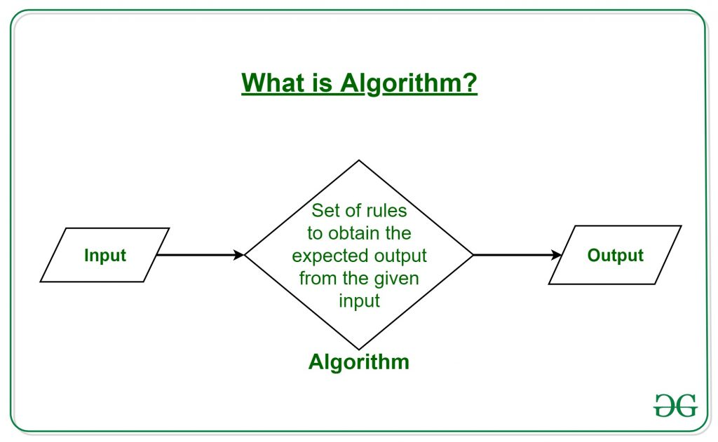

Slide 4
Areas for the study of algorithms:
How to devise an algorithm
How to validate an algorithm
How to analyze an algorithm
How to test a program
▪ Debugging
▪ Profiling

Slide 5
How to devise an algorithm
To design new algorithm, we apply an existing design strategy.
Some of the existing strategies are
Divide and Conquer
Greedy Method
Dynamic Programming
Back Tracking
Branch and Bound etc.
How to validate an algorithm
Once an algorithm is devised , it is necessary to show that it computes the correct answer for all possible legal inputs .
The purpose of validation is to assure us that this algorithm will work correctly independently of the issues concerning the programming language it will eventually be written in.
We use Mathematical proof of correctness by Induction, Loop Invariant.

Slide 6
3. How to analyze an algorithm
Based on performance measures such as space and time
i) How much time required
ii) How much space required
How to test a program
▪ Debugging
▪ Profiling
Debugging is a process of executing program on sample data sets, to
determine whether any fault results occur. If so correct them.
Profiling is a process of executing a correct program on sample data sets and
determine how much time/space required by program

Slide 7
Representation and Structure of an Algorithm:
We can describe an algorithm in many ways.
We can use a natural language like English, but if we select this option,
we must make sure that the resulting instructions are definite.
Graphic representations called flow charts are another possibility, but
they work well only if the algorithm is small and simple.
We can also represent algorithms using pseudo code that resemble C
and Pascal.

Slide 8
How to Design an Algorithm?
In order to write an algorithm, following things are needed as a pre-requisite:
The problem that is to be solved by this algorithm.
The constraints of the problem that must be considered while solving the problem.
The input to be taken to solve the problem.
The output to be expected when the problem the is solved.
The solution to this problem, in the given constraints.
Then the algorithm is written with the help of above parameters such that it solves the problem.

Slide 9
.
1. Comments begin with // and continue until end of the line.
2. Blocks are indicated with matching braces: { and }.
A compound statement
Body of a procedure.
3.
An identifier begins with a letter.
The data types of variables are not explicitly declared.
Whether a variable is global or local to a procedure will also be evident
from the context.
We assume simple data types such as integer, float, char, boolean, and so on.

Slide 10
4. Assignment of values to variables is done using the assignment
statement.
< variable > := < expression >
5. There are two boolean values true and false. To produce these values,
logical operators and, or and not and the relational operators <, ≤,=, ≠, ≥
and > are provided.
6. Elements of multidimensional arrays are accessed using [ and ]. For example the (i,j)th element of the array A is denoted as A[i,j].

Slide 11
The following looping statements are used: while, for and repeat until.
i) The general form of a while loop:
while( condition ) do
{
statement_1;
:
statement_n;
}
ii) The general form of a for loop:
for variable := value1 to value2 step step do

Slide 12
iii) The general form of a repeat-until loop:
repeat
<statement 1>
:
<statement n>
until ( condition )
The statements are executed as long as condition is false
8. A conditional statement has the following
forms:
if < condition > then < statement >
if < condition > then
< statement 1>
else
< statement 2>
9. Input and output are done using the instructions read and write.
Ex: read n;
write n;

Slide 13
10. Procedure or function starts with the word
Algorithm.
General form :
Algorithm Name( <parameter list> )
{
body
}
where Name is the name of the procedure.
Simple variables to procedures are passed by value.
Arrays and records are passed by reference

Slide 14
Write an algorithm to find sum of n numbers in the given list
Algorithm sum(a,n)
{
s:=0;
for i:=1 to n do
s:=s+a[i];
return s;
}

Slide 15
Write an algorithm to find factorial of a given number.

Slide 16
Thank you

